Slide 1
Flocking
Based on the slides of Bruce MacLennan, University of Tennessee

Slide 2
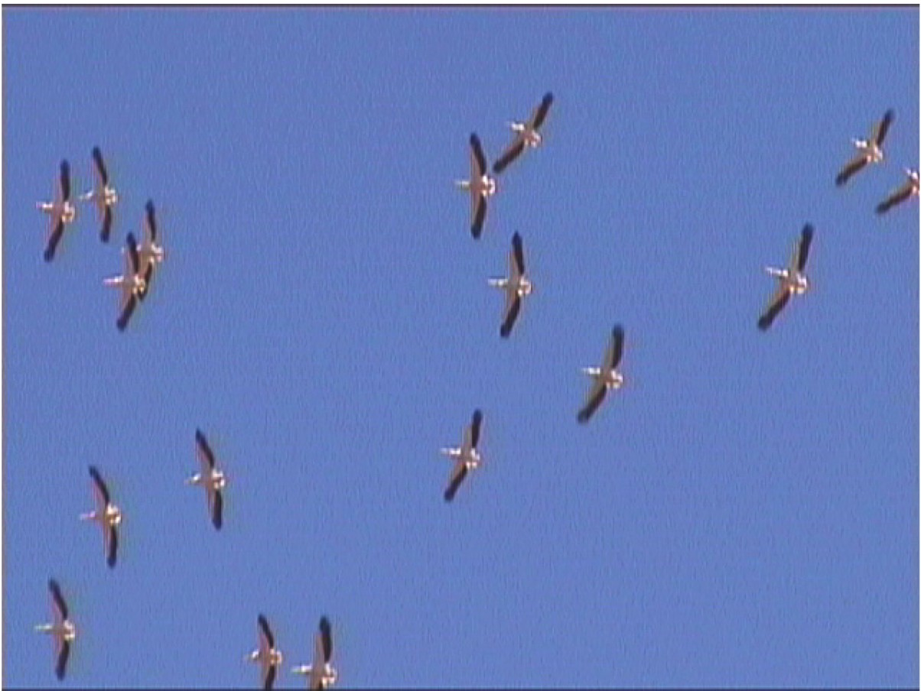
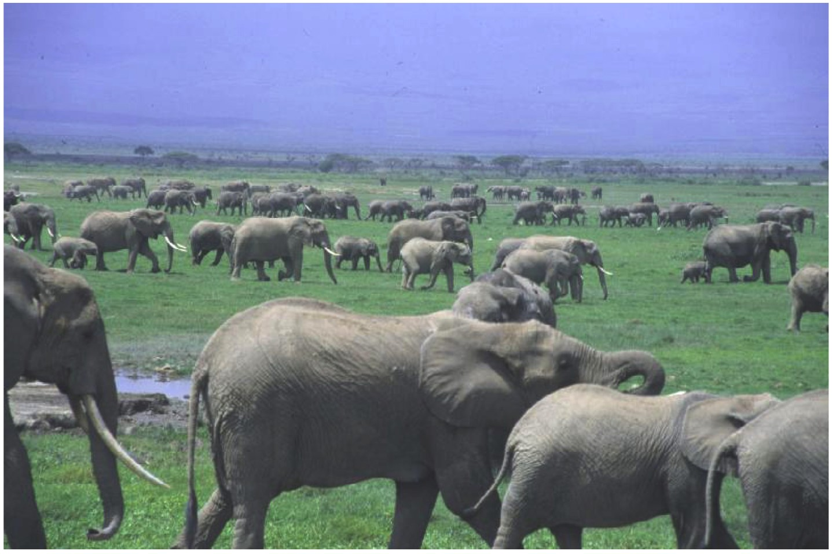
Schools, Flocks, & Herds
“and the thousands of fishes moved as a huge beast, piercing the water. They appeared united, inexorably bound to a common fate. How comes this unity?”
— anon., 17th cent.
Notes:
(quote from SOBS 167)

Slide 3
Coordinated Collective Movement
Groups of animals can behave almost like a single organism
Can execute swift maneuvers
for predation or to avoid predation
Individuals rarely collide, even in frenzy of attack or escape
Shape is characteristic of species, but flexible
Notes:
(SOBS 167, 169, 173)

Slide 4
Adaptive Significance
Prey avoiding predation
More efficient predation by predators
Other Efficiencies
Avoiding Predation
More compact aggregation
predator risks injury by attacking
Confusing predator by:
united erratic maneuvers (e.g. zigzagging)
separation into subgroups (e.g., flash expansion & fountain effect)

Slide 5
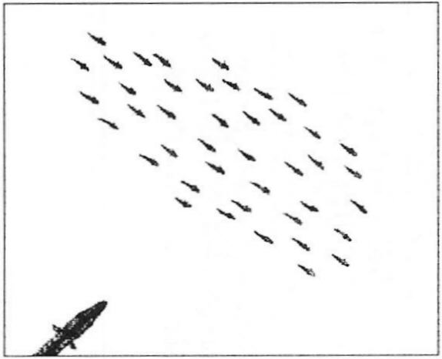
Flash Expansion
Fig. from Camazine & al., Self-Org. Biol. Sys.
Notes:
an evasive maneuver in which a school rapidly expands and bursts radially
(SOBS 169)

Slide 6
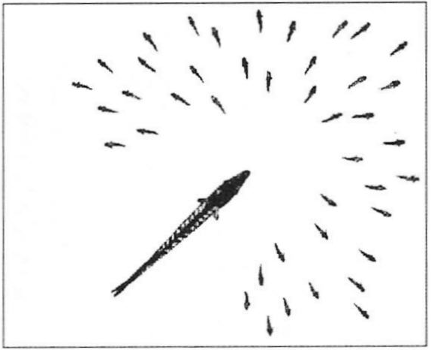
Flash Expansion
Fig. from Camazine & al., Self-Org. Biol. Sys.

Slide 7
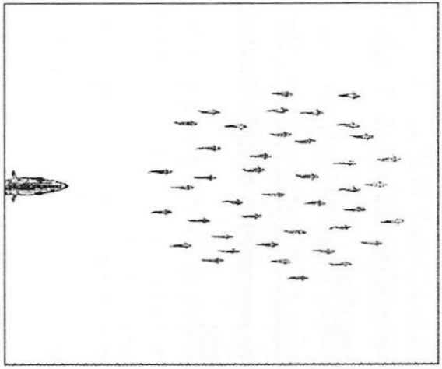
Fountain Effect
Fig. from Camazine & al., Self-Org. Biol. Sys.
Notes:
school of small, slow-moving prey outmaneuver predator by splitting into two groups
(SOBS 169)

Slide 8
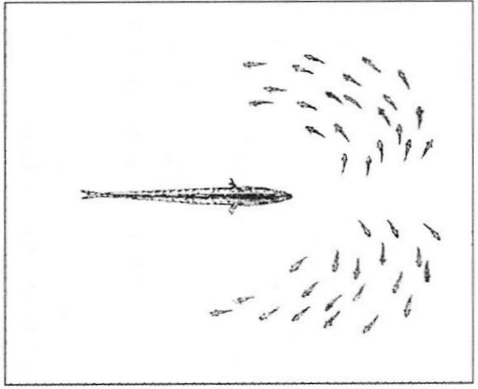
Fountain Effect
Fig. from Camazine & al., Self-Org. Biol. Sys.

Slide 9
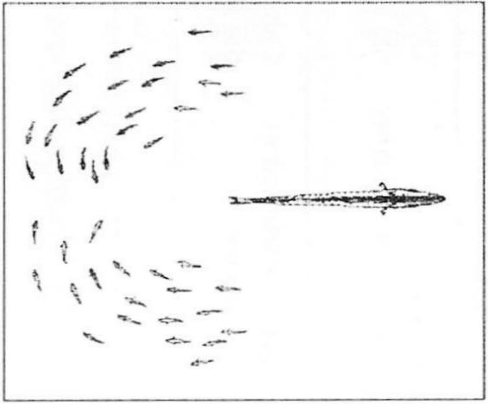
Fountain Effect
Fig. from Camazine & al., Self-Org. Biol. Sys.
Notes:
they regroup behind the predator
(SOBS 169)

Slide 10
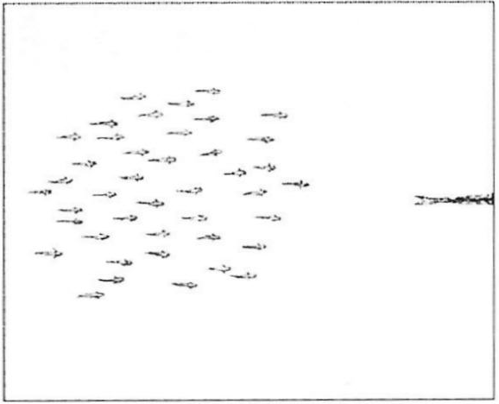
Fountain Effect
Fig. from Camazine & al., Self-Org. Biol. Sys.

Slide 11
Better Predation
Coordinated movements to trap prey
e.g. parabolic formation of tuna
More efficient predation
e.g., killer whales encircle dolphins
take turns eating
Other Efficiencies
Fish schooling may increase hydrodynamic efficiency
endurance may be increased up to 6×
school acts like “group-level vehicle”
V-formation increases efficiency of geese
range 70% greater than that of individual
Lobsters line up single file by touch
move 40% faster than when isolated
decreased hydrodynamic drag
Notes:
(SOBS 175)

Slide 12
Characteristic Arrangement of School
Shape is characteristic of species
Fish have preferred distance, elevation & bearing relative to neighbors
Fish avoid coming within a certain minimum distance
closer in larger schools
closer in faster moving schools
Self-Organization Hypothesis
Simple attraction & repulsion rules generate schooling behavior
positive feedback: brings individuals together
negative feedback: but not too close
Rules rely on local information
i.e. positions & headings of a few nearby fish
no global plan or centralized leader
Notes:
(SOBS 173)

Slide 13
Mechanisms of Individual Coordination
Vision
governs attraction and
alignment
Lateral line
sensitive to water movement
provides information on speed & direction of neighbors
governs repulsion
& speed matching
How is this information integrated into a behavioral plan?
most sensitive to nearest neighbors
Notes:
Lateral line:
gelatinous canals along side
connected to outside via pores
hair cells respond to water movement (similar to ears)
(SOBS 177-8)

Slide 14
Basic Assumptions of Huth & Wissel (1992) Model
All fish follow same rules
Each uses some sort of weighted average of positions & orientations of nearest neighbors
Fish respond to neighbors probabilistically
imperfect information gathering
imperfect execution of actions
No external influences affect fish
e.g. no water currents, obstacles, …
Notes:
There is little evidence how fish prioritize or average conflicting behavioral tendencies
Averaging models (e.g. over four nearest neighbors) seem to produce the most realistic behavior
(SOBS 180)

Slide 15
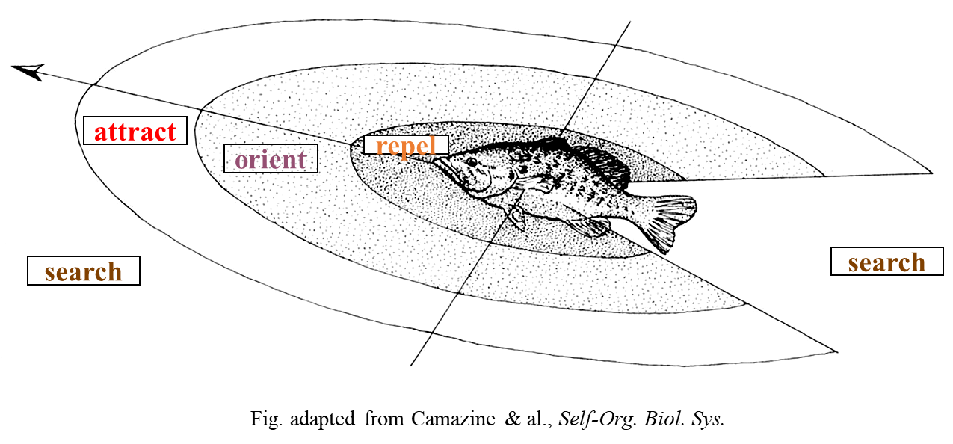
Huth & Wissel:Model Behavior of Individual
Determine a target direction from each of three nearest neighbors:
if in repel range, then 180° + direction to neighbor
else if in orient range, then heading of neighbor
else if in attract range, then
accelerate if ahead, decelerate if behind;
return direction to neighbor
else return our own current heading
Determine overall target direc. as average of 3 neighbors inversely weighted by their distances
Turn a fraction in this direction (determined by flexibility) + some randomness

Slide 16
Limitations of Model
Model addresses only motion in absence of external influences
Ignores obstacle avoidance
Ignores avoidance behaviors such as:
flash expansion
fountain effect
Recent work (since 1997) has addressed some of these issues
Notes:
(SOBS 185-6)

Slide 17
“Boids”
A model of flocks, herds, and similar cases of coordinated animal motion by Craig Reynolds (1986)

Slide 18
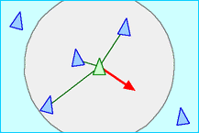
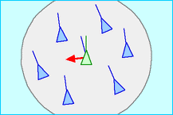
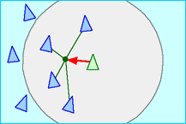
Reynolds' Algorithm: Basic Ideas
The basic flocking model consists of three simple steering behaviors which describe how an individual boid maneuvers based on the positions and velocities its nearby flockmates.
Separation: steer to avoid crowding local flockmates
Alignment: steer towards the average heading of local flockmates
Cohesion: steer to move toward the average position of local flockmates
Simple Boid Video
Boids in Batman
Boids with Attraction and Avoidance

Slide 19
Reynolds' Algorithm: Separation
The basic flocking model consists of three simple steering behaviors which describe how an individual boid maneuvers based on the positions and velocities its nearby flockmates.
var v : Point = new Point();
var neighborCount = 0;
foreach (agent in agents) // agents: list of agents
{
if (agent != myAgent)
{
if (myAgent.distanceFrom(agent) < RADIUS)
{
v.x += agent.x - myAgent.x; // Sum Position Differences
v.y += agent.y - myAgent.y;
neighborCount++;
}
}
}
if (neighborCount == 0) return new Point();
v.x /= neighborCount; // Average Differences
v.y /= neighborCount;
v.x *= -1; // Move in the opposite direction
v.y *= -1;
v.normalize(1);
return v;
Separation: steer to avoid crowding local flockmates

Slide 20
Reynolds' Algorithm: Alignment
The basic flocking model consists of three simple steering behaviors which describe how an individual boid maneuvers based on the positions and velocities its nearby flockmates.
var v : Point = new Point();
var neighborCount = 0;
foreach (agent in agents) // agents: list of agents
{
if (agent != myAgent)
{
if (myAgent.distanceFrom(agent) < RADIUS)
{
v.x += agent.velocity.x; // Sum velocities
v.y += agent.velocity.y;
neighborCount++;
}
}
}
if (neighborCount == 0) return new Point();
v.x /= neighborCount; // Average velocities
v.y /= neighborCount;
v.normalize(1);
return v;
Alignment: steer towards the average heading of local flockmates

Slide 21
Reynolds' Algorithm: Cohesion
The basic flocking model consists of three simple steering behaviors which describe how an individual boid maneuvers based on the positions and velocities its nearby flockmates.
var v : Point = new Point();
var neighborCount = 0;
foreach (agent in agents) // agents: list of agents
{
if (agent != myAgent)
{
if (myAgent.distanceFrom(agent) < RADIUS)
{
v.x += agent.x; // Sum Positions
v.y += agent.y;
neighborCount++;
}
}
}
if (neighborCount == 0) return new Point();
v.x /= neighborCount; // Average Positions
v.y /= neighborCount;
v = new Point(v.x - myAgent.x, v.y - myAgent.y);
v.normalize(1);
return v;
Cohesion: steer to move toward the average position of local flockmates; this is the "center of mass" (with its neighbors)
v corresponds to the center of mass; we don't want the center of mass itself.
We want the direction toward the center of mass: the distance from the agent to the center of mass.

Slide 22
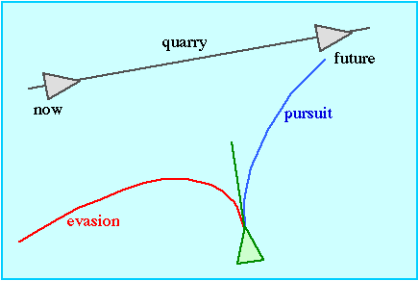
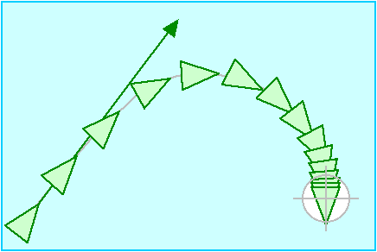
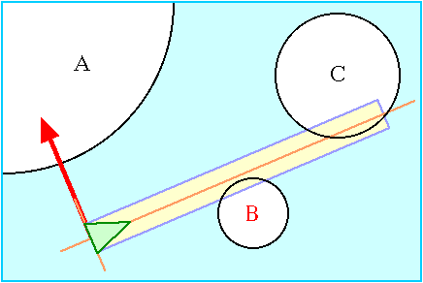
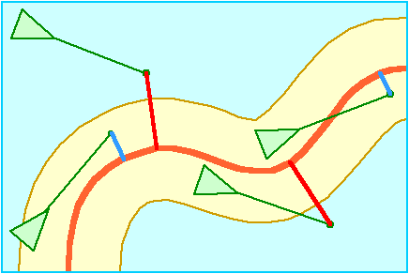
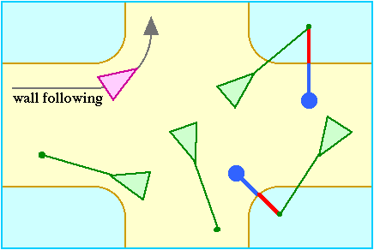
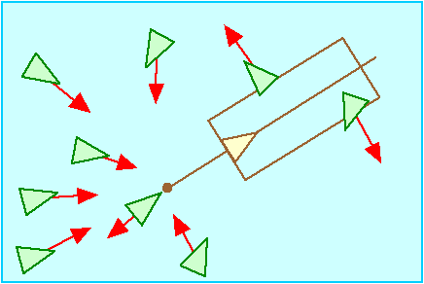
Steering: More complex behaviors
Craig W. Reynolds, Steering Behaviors For Autonomous Characters, Game Developers Conference, 1999.
Craig Reynolds' Steering Behaviors for Autonomous Characters
Pursuit and Evasion
Arrival
Obstacle Avoidance
path following
wall following
Leader following

Slide 23
Flocking in RTS Games (and Other)
Empire Earth Sample
Starcraft
Black and White
Some dude's game.
Half-Life

